Slide 1
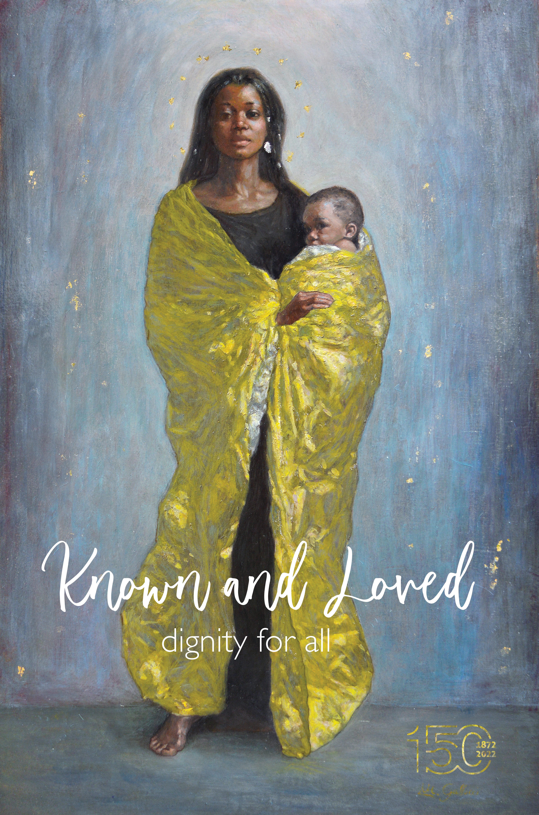

Slide 4
dignity for all

