Slide 1
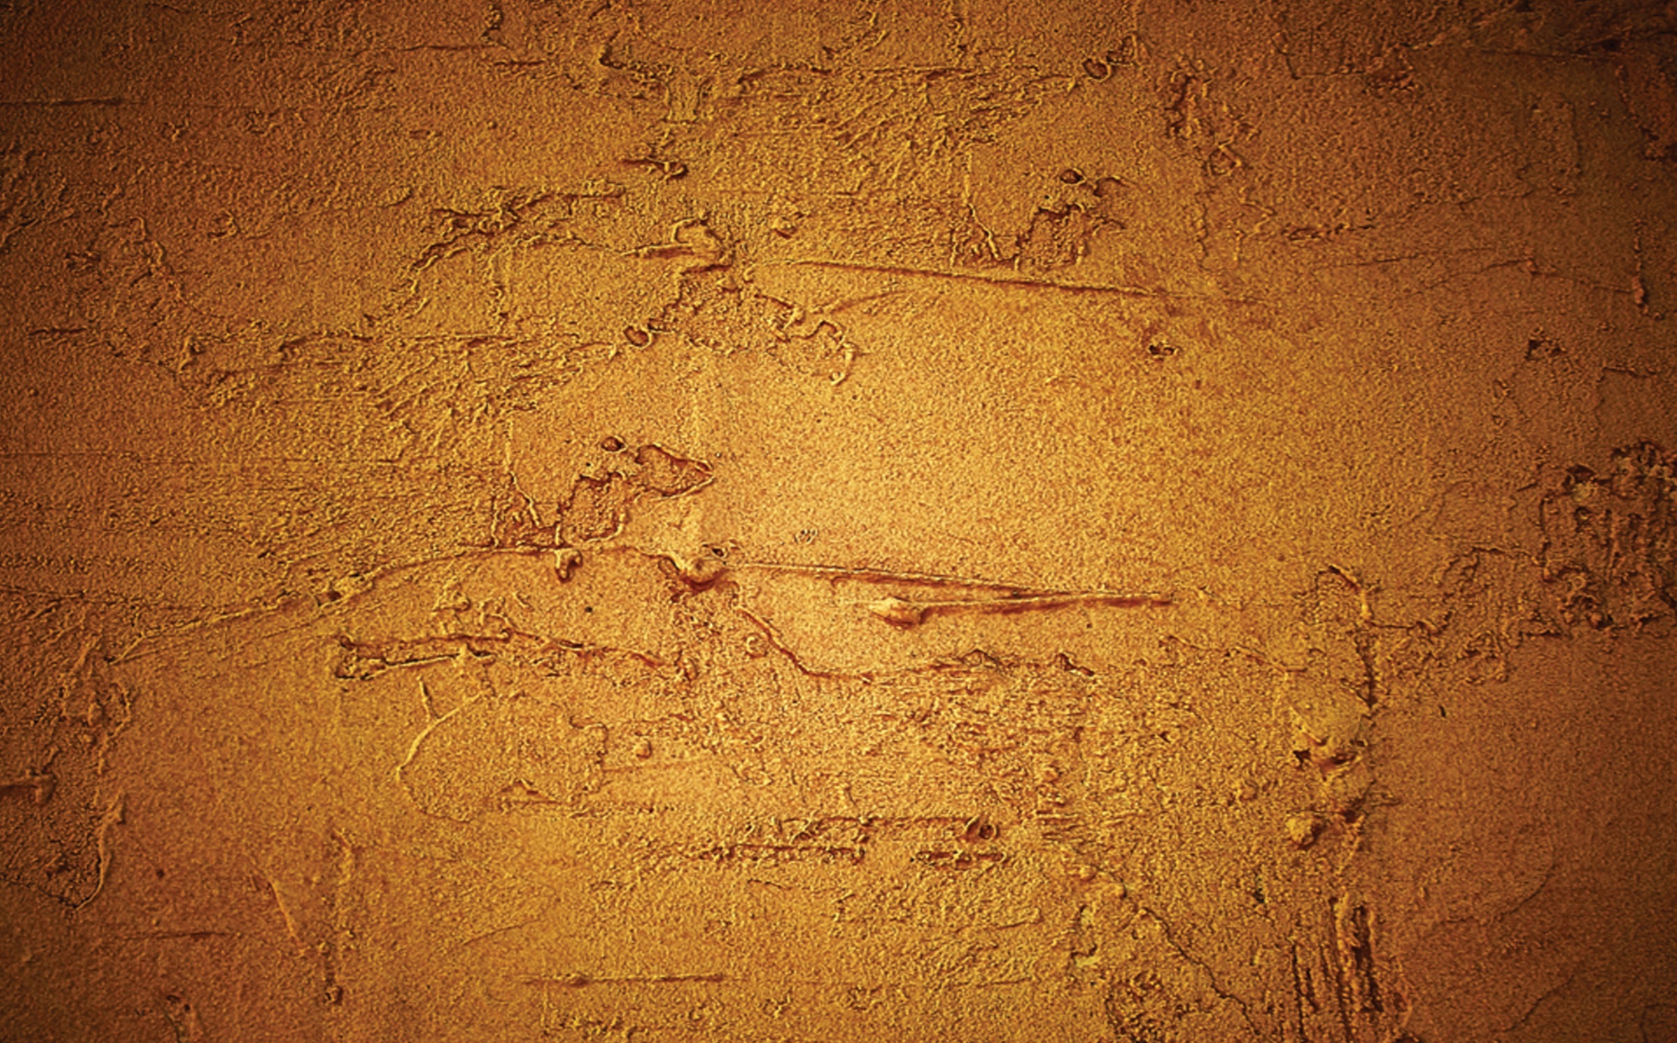
Feast of Saint Marcellin
Champagnat 2014

Slide 2
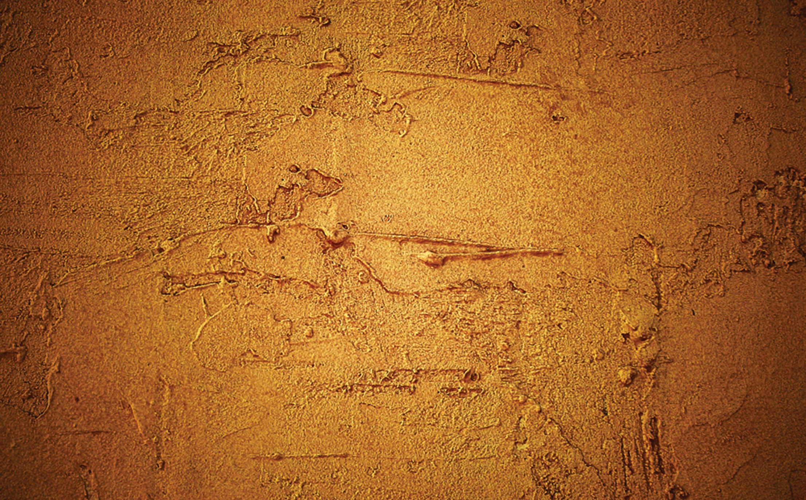
Feast of Saint Marcellin
Champagnat 2014
Certain images and/or photos on this page are the copyrighted property of 123RF Limited, their Contributors or Licensed Partners and are being used with permission under license. These images and/or photos may not be copied or downloaded without permission from 123RF Limited

