Slide 1
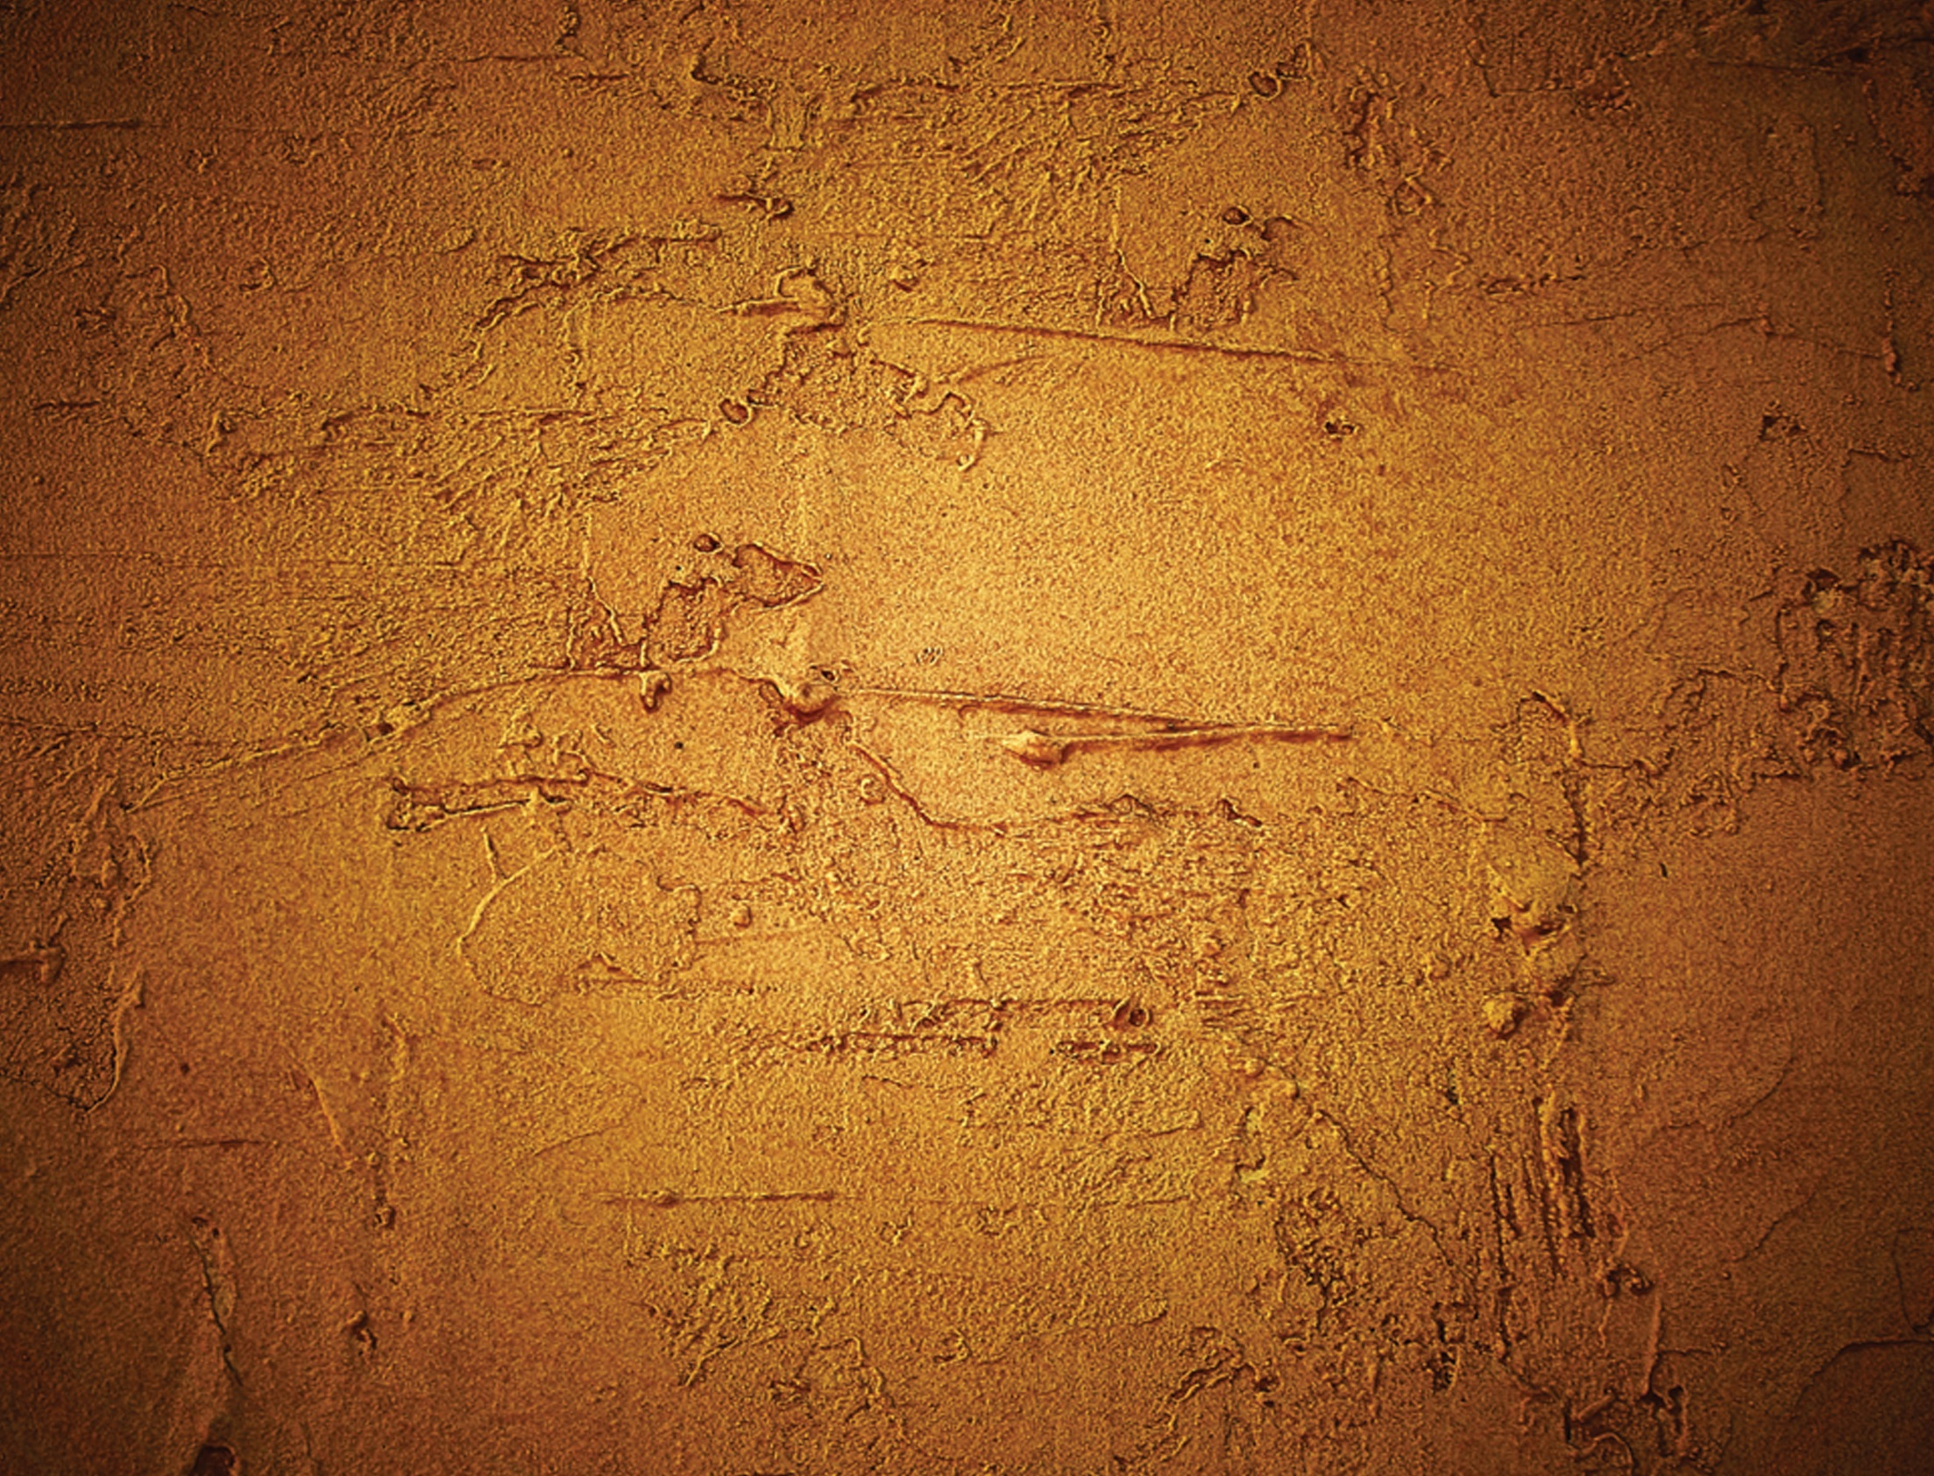
Feast of Saint Marcellin
Champagnat 2014

Slide 2
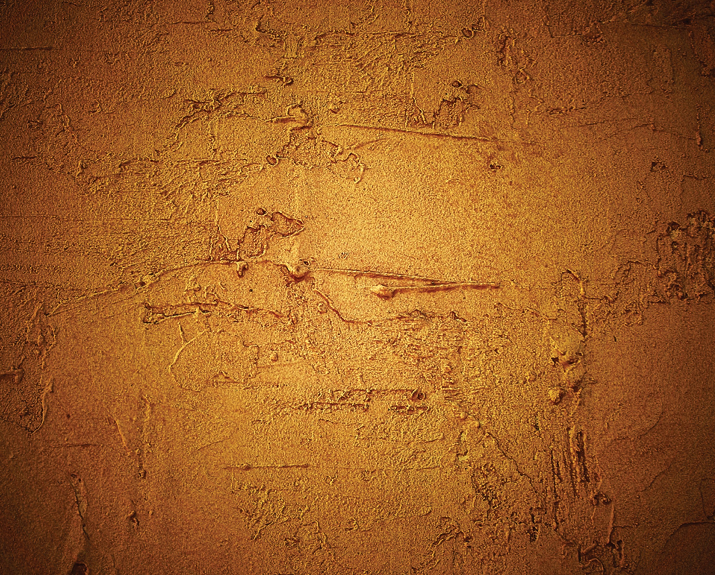
Feast of Saint Marcellin
Champagnat 2014

